Slide 1

Notes:
First off we start with a simple splash screen with the game’s title

Slide 2
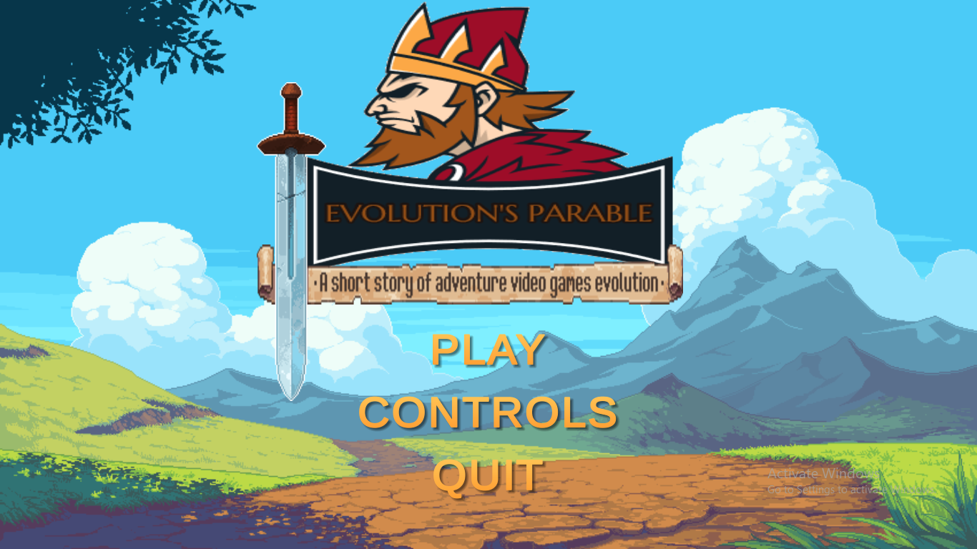
Notes:
At the main menu, there are three buttons:
Play (Start Game)
Controls (Game Controls)
Quit (Exit Game)
And a hidden button ☺

Slide 3
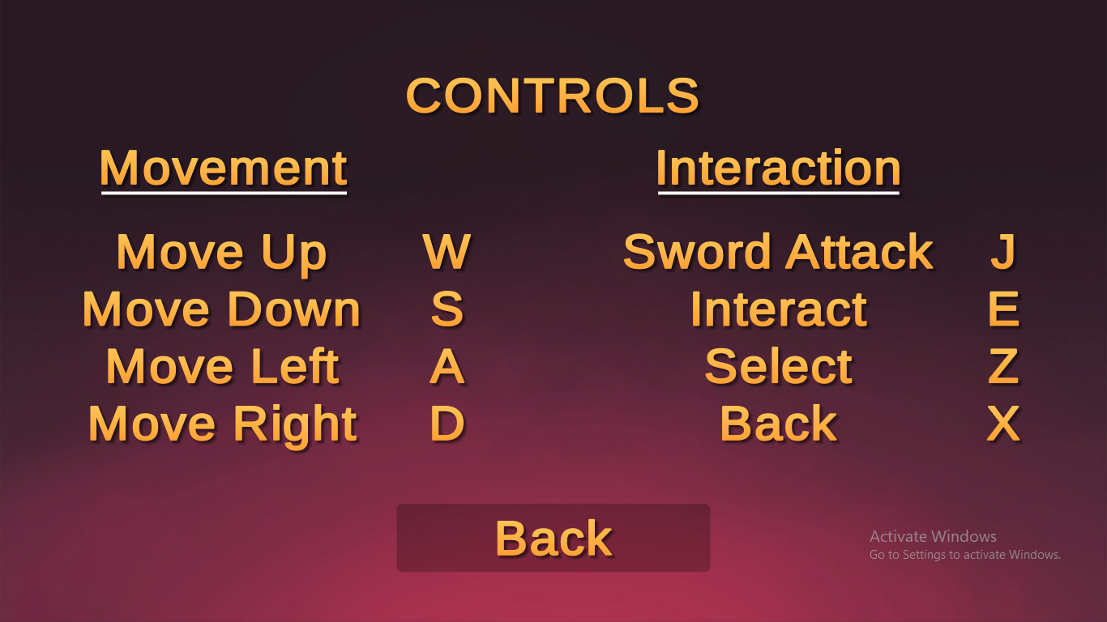
Notes:
This is the Controls Screen

Slide 4
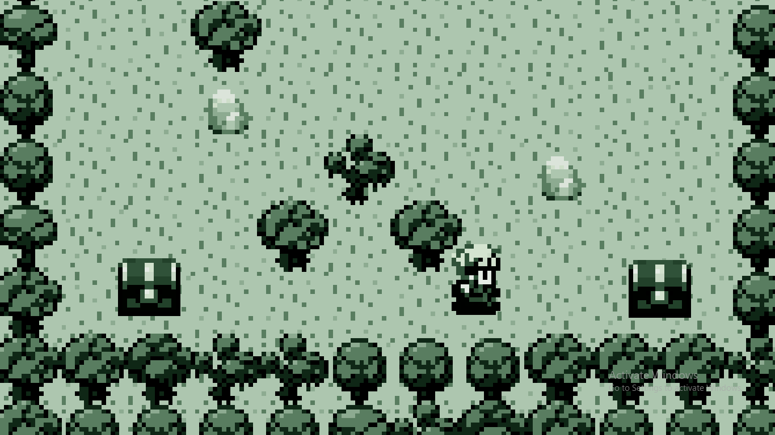
Notes:
Once you enter, you can only move right. Pick up the chest on the right and now you have left movement!!
The chest on the left finally allows 2d movement.

Slide 5
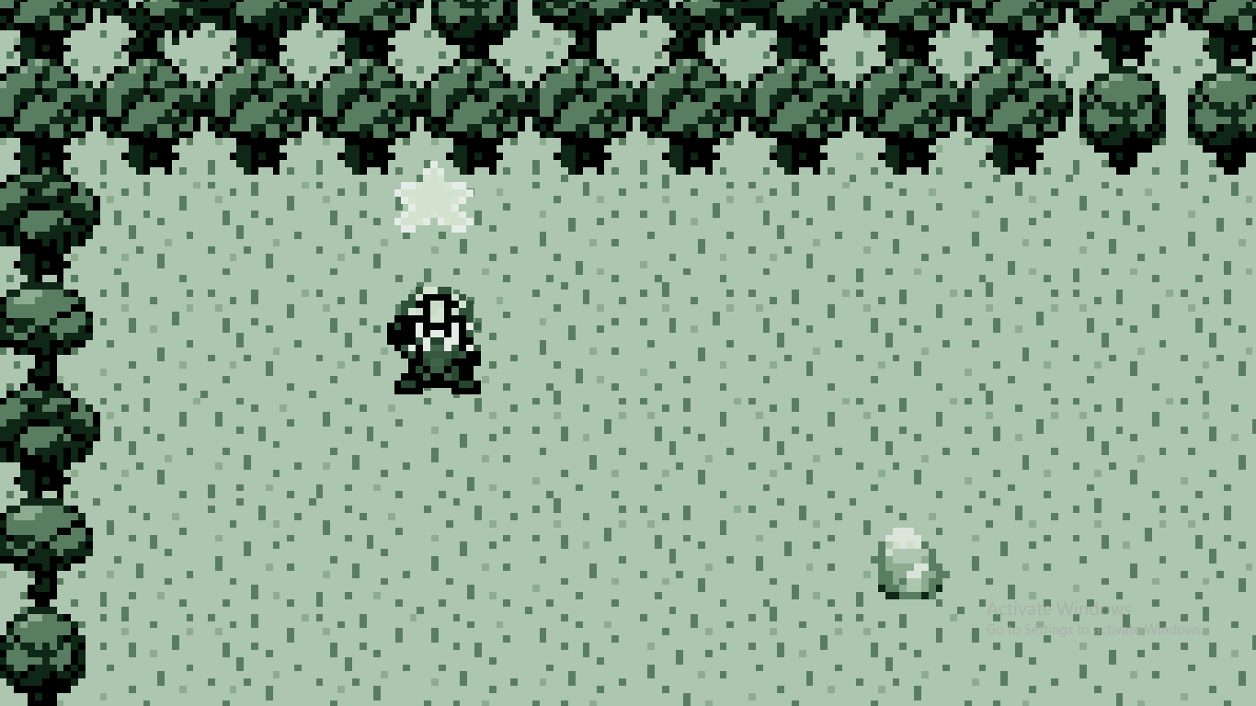
Notes:
There are hidden chests containing stars which would serve as an extra goal for the player.

Slide 6
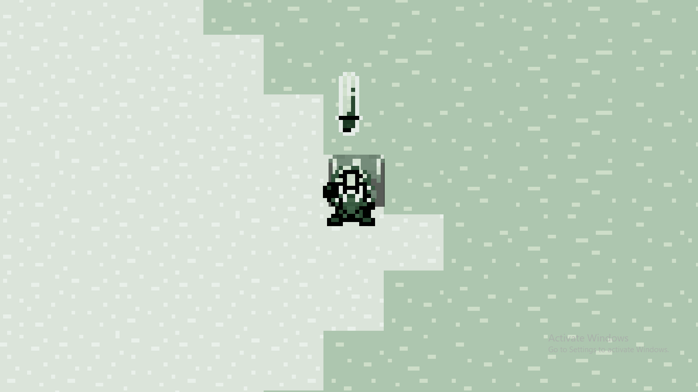
Notes:
Advancing through the game you finally find your sword which you can cut through bushes (but don’t stand too close, the sword will get tangled!) and beat your enemies!

Slide 7
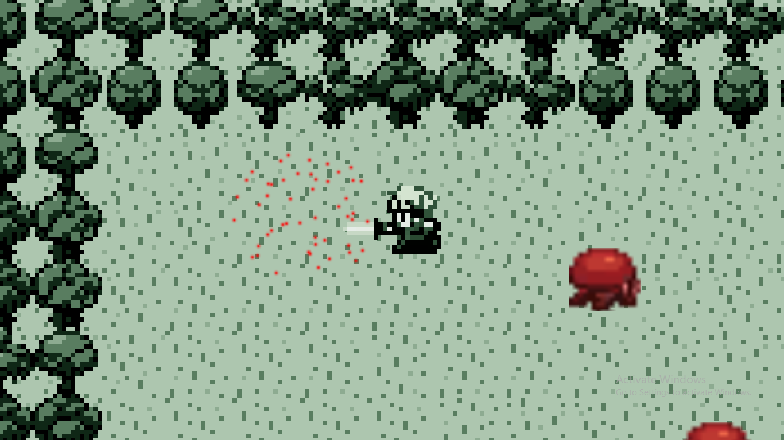
Notes:
Destroy monsters with one swoop of your sword and disintegrate them to particles.

Slide 8
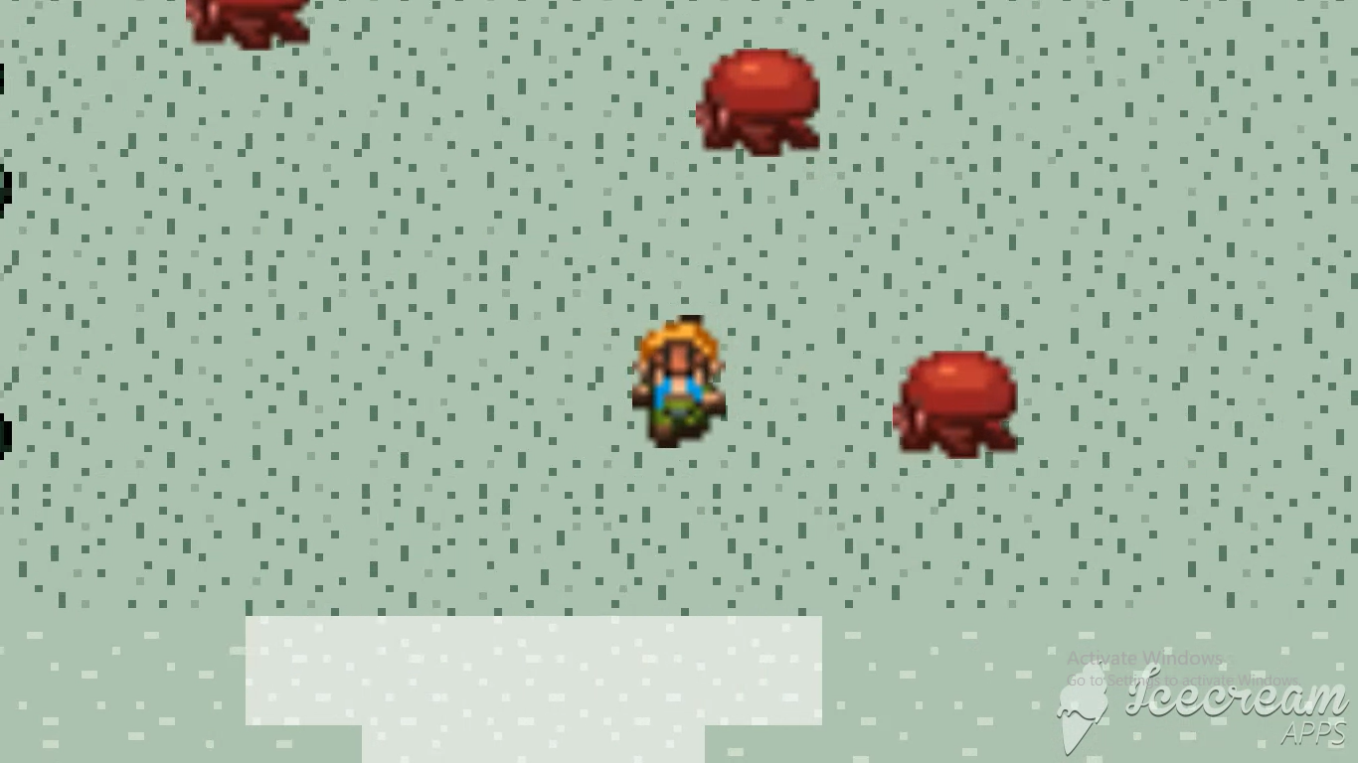
Notes:
However, make sure you don’t get hit by them or else you’ll cry! Hitting a monster will push you away the direction the monster is coming from and getting hurt too much will result in game over ☹! It’s okay though, their movement is very simple :D

Slide 9
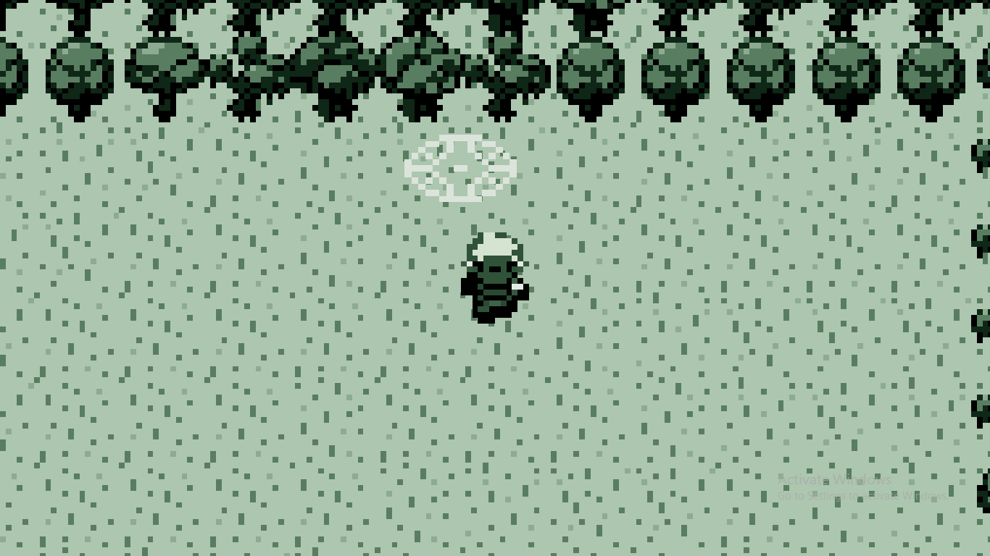
Notes:
Kill all the monsters to find the dimensional portal and advance to the next level!

Slide 10
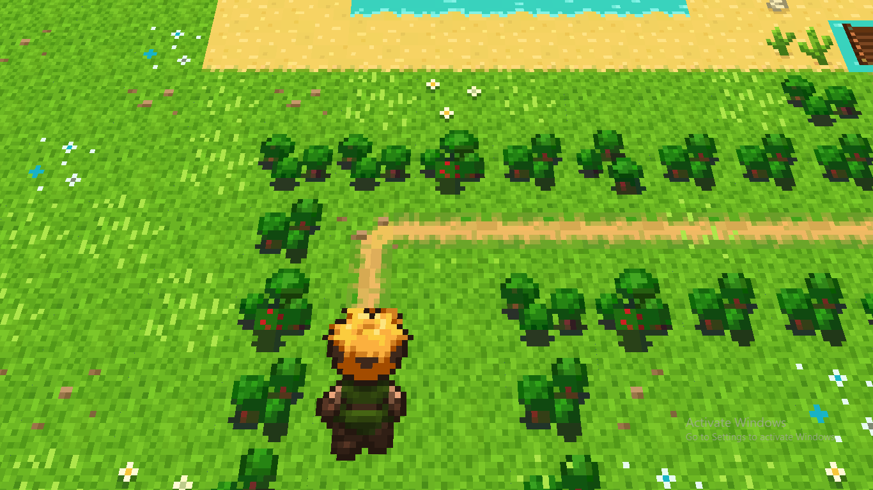
Notes:
Now you’re in the overworld!

Slide 11
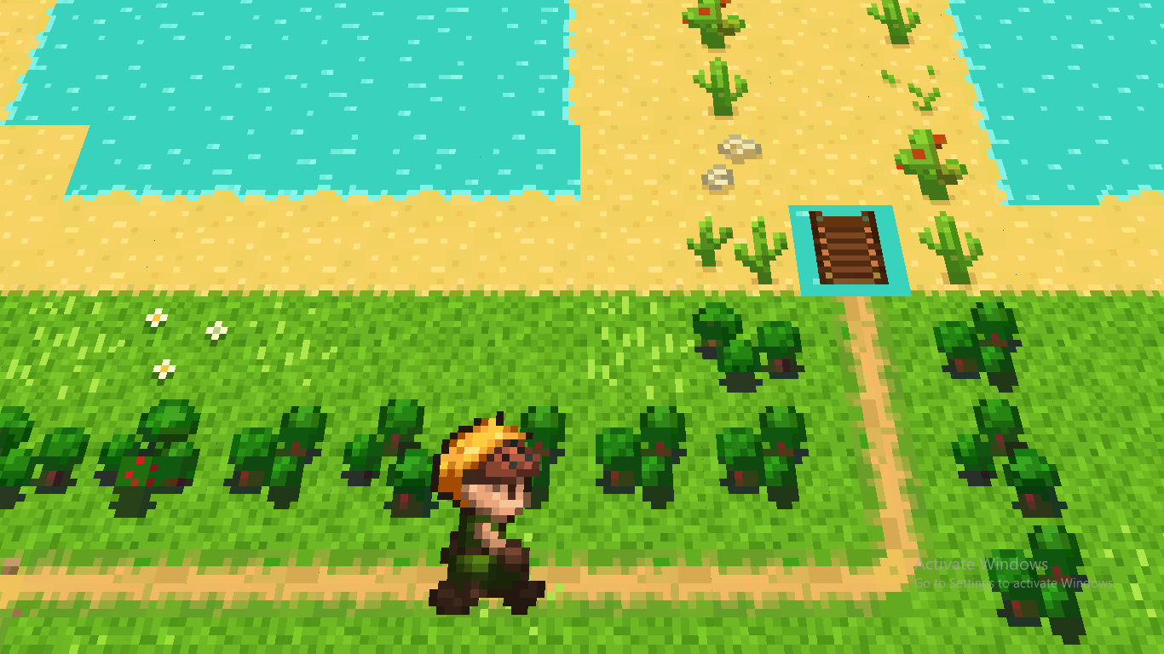
Notes:
Moving would result in random encounters with wild monsters (Pokémon style!)

Slide 12
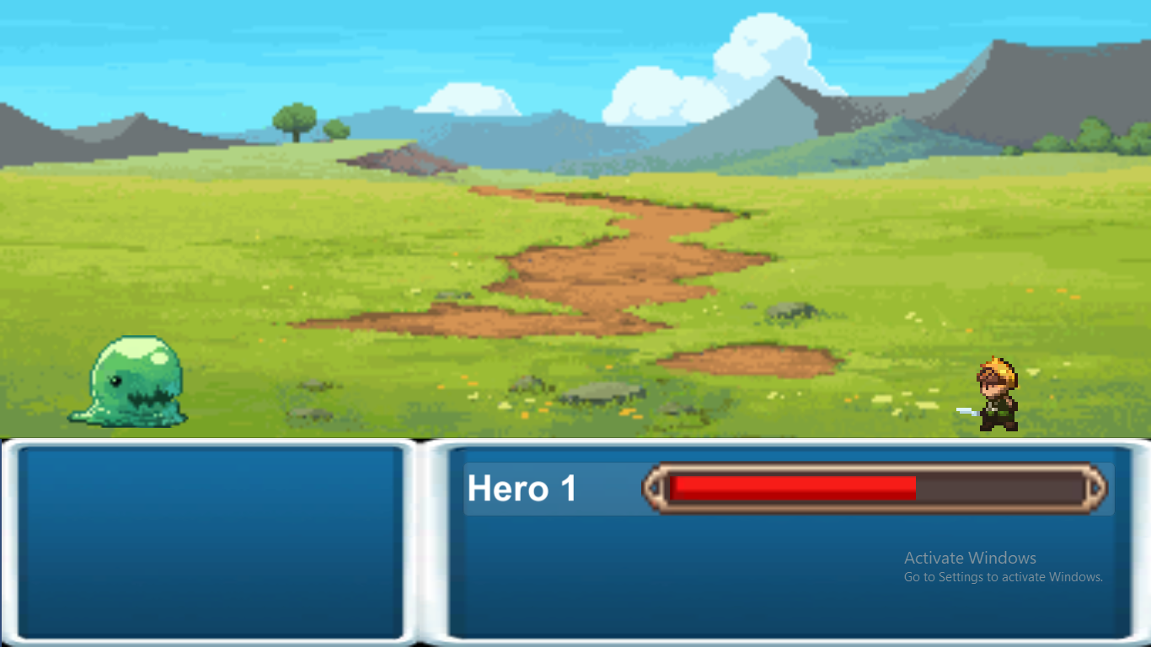
Notes:
Your health will pick up where you left the last battle so make sure you stock up on healing potions and get rest first!

Slide 13
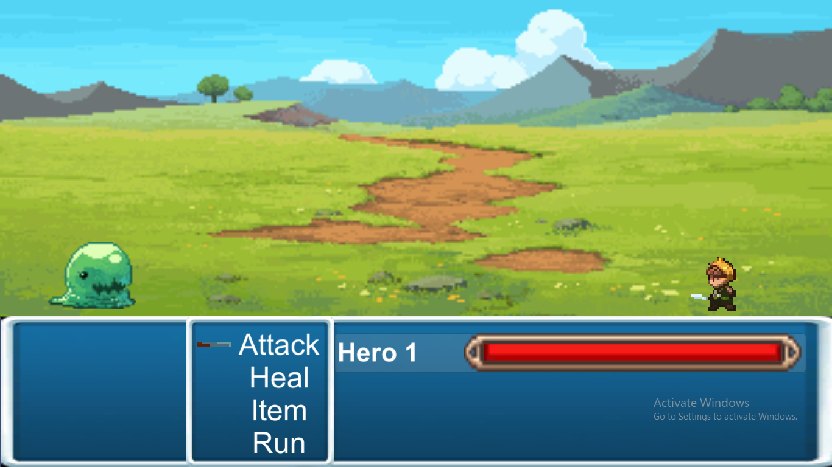
Notes:
Pressing select for your chosen hero will open up a menu. Here you can choose whether to melee attack, cast healing magic, use an item, or attempt to escape!

Slide 14
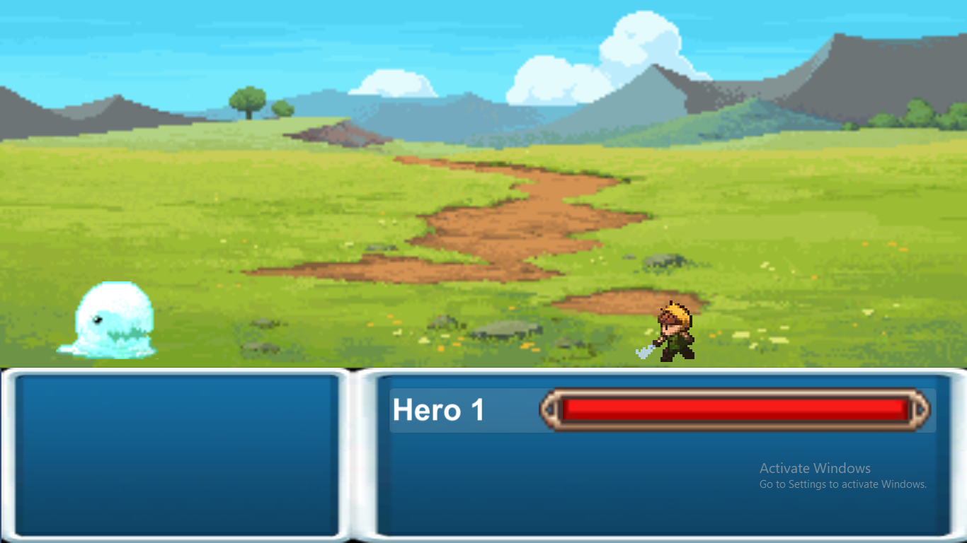
Notes:
Here the hero is attacking the monster!

Slide 15
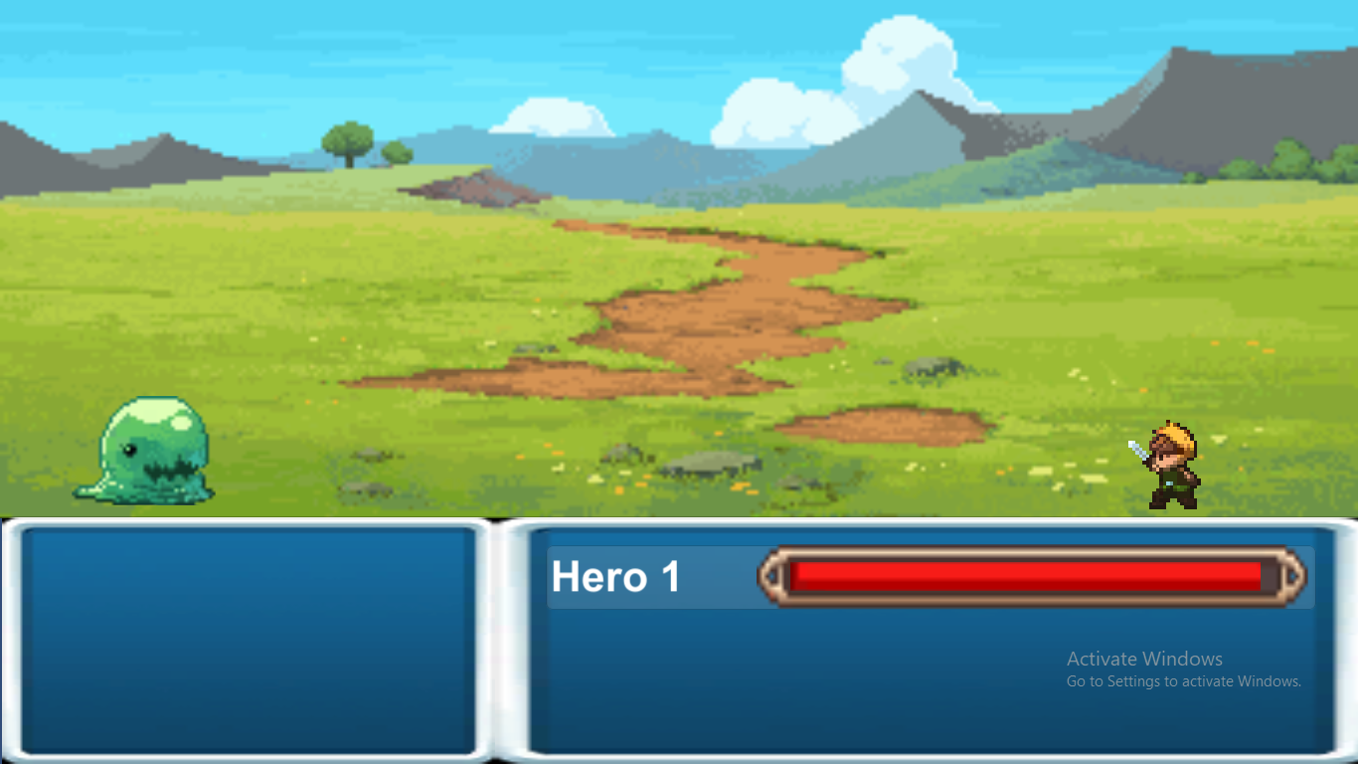
Notes:
You lift your sword high as you cast a healing spell!

Slide 16
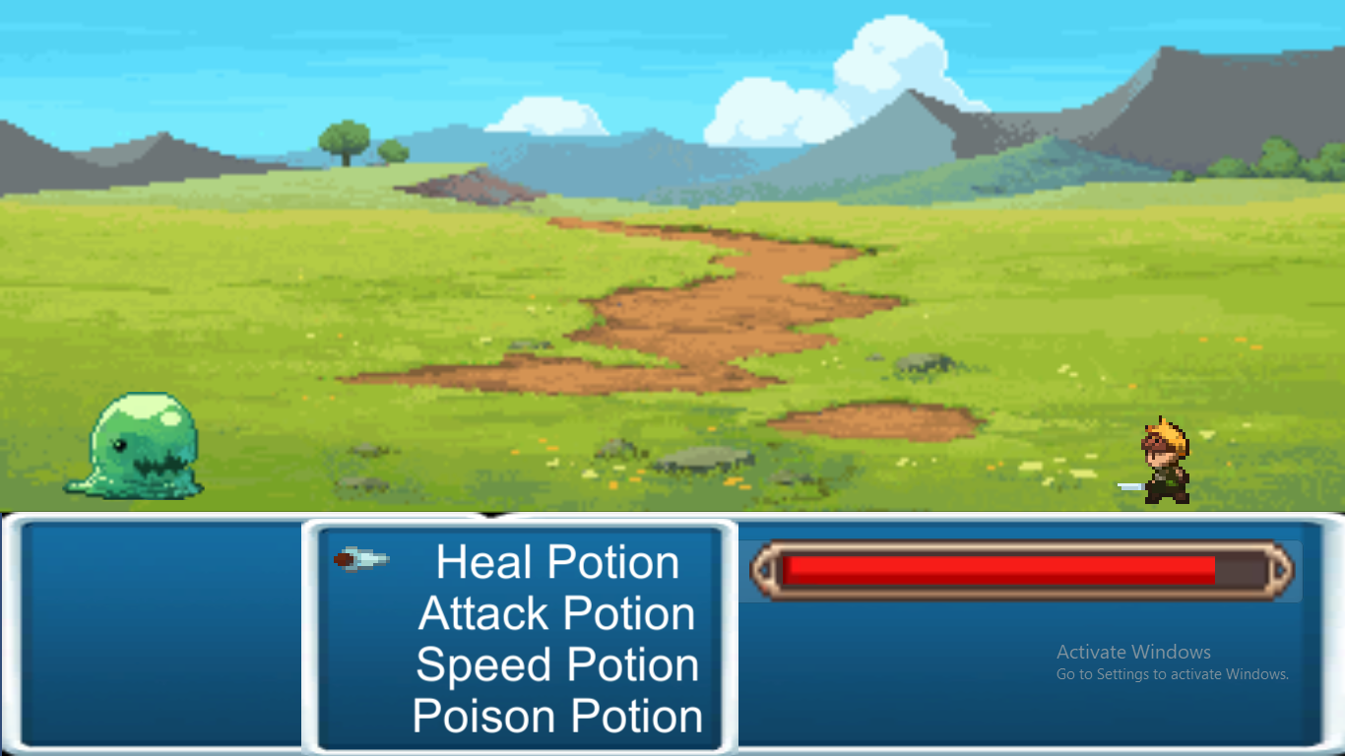
Notes:
The items are straightforward as explained by the potion seller:
Heal Potion heals you completely, Attack Potion doubles your attack for this fight, Speed Potion gives you increased chances of escaping, and Poison Potion throws a vile of poison on your enemy which damages them every turn.

Slide 17
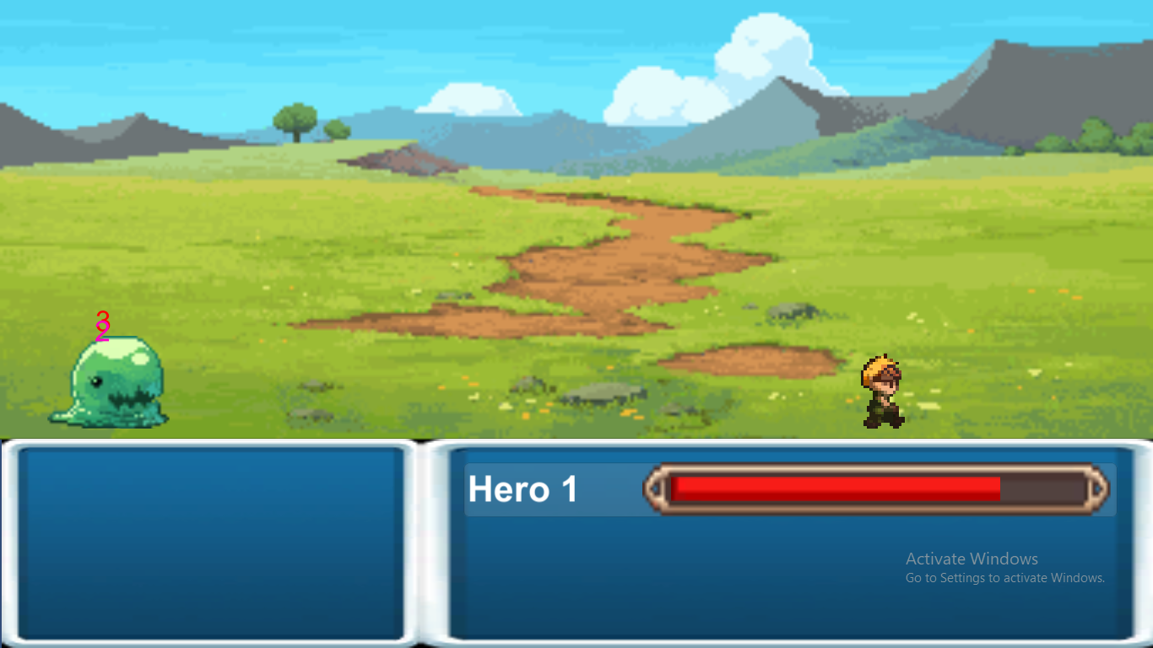
Notes:
Potion damage stacks up with melee attack damage as well!!

Slide 18
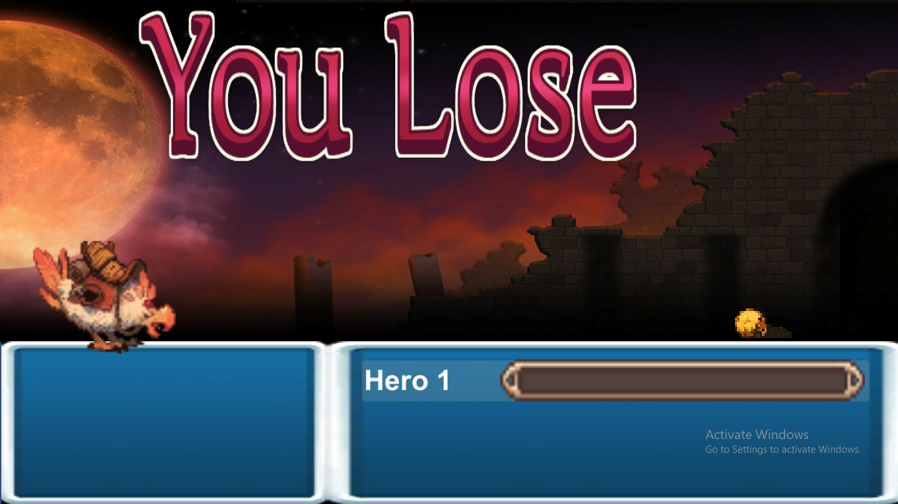
Notes:
If your health drop to below zero you lose the game ☹

Slide 19
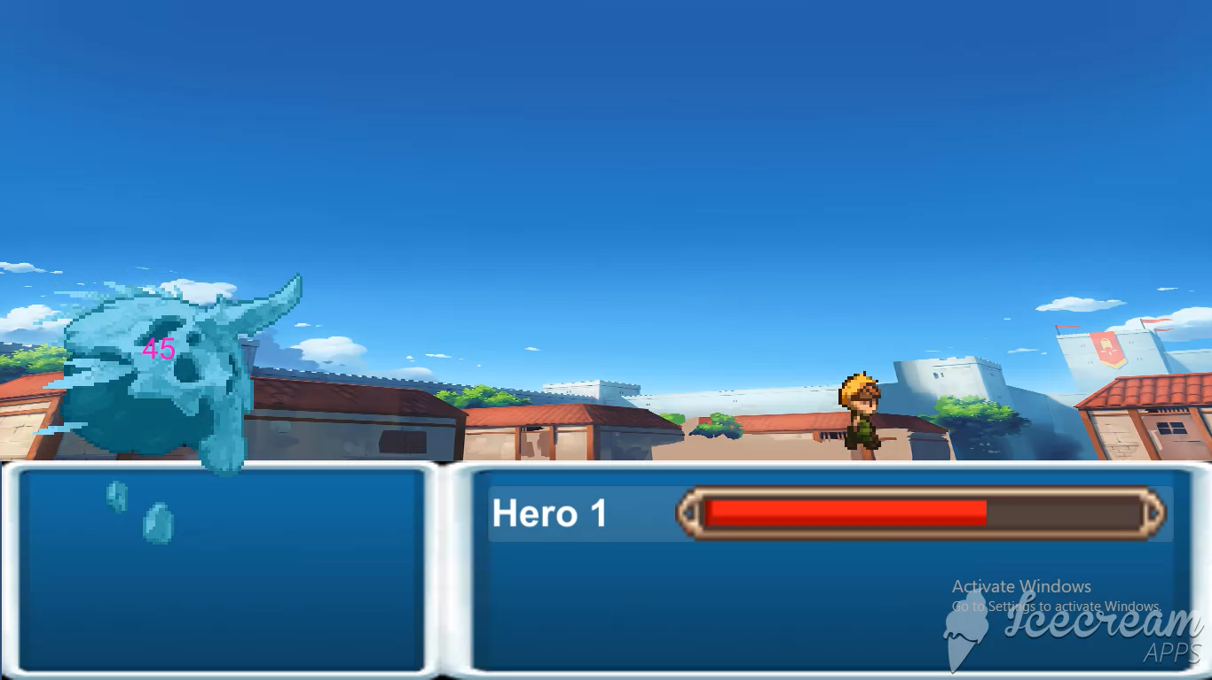
Notes:
Hint: Save up your attack potion for the final battle against the final boss!!

Slide 20
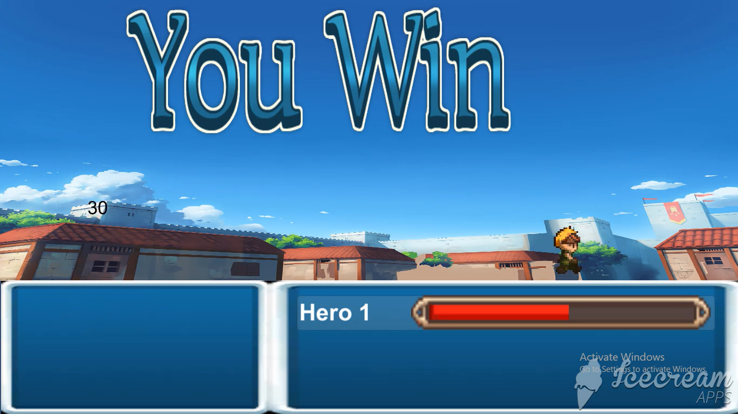
Notes:
Nothing better than the sweet taste of victory!!

Slide 21
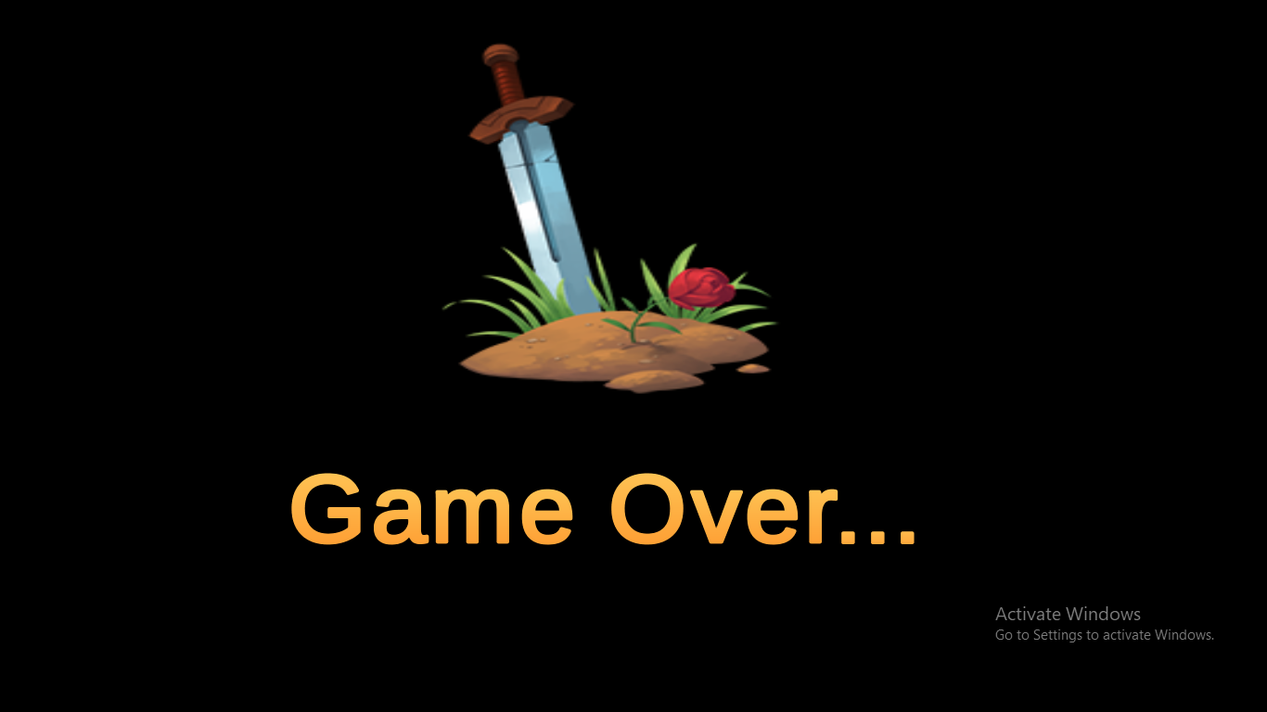
Notes:
And then, it’s game over ☹

Slide 22
THANK YOU!
Notes:
Thank you for playing!!

